Slide 1

Toolkit Doc8 Spine
April 29, 2010

Slide 2
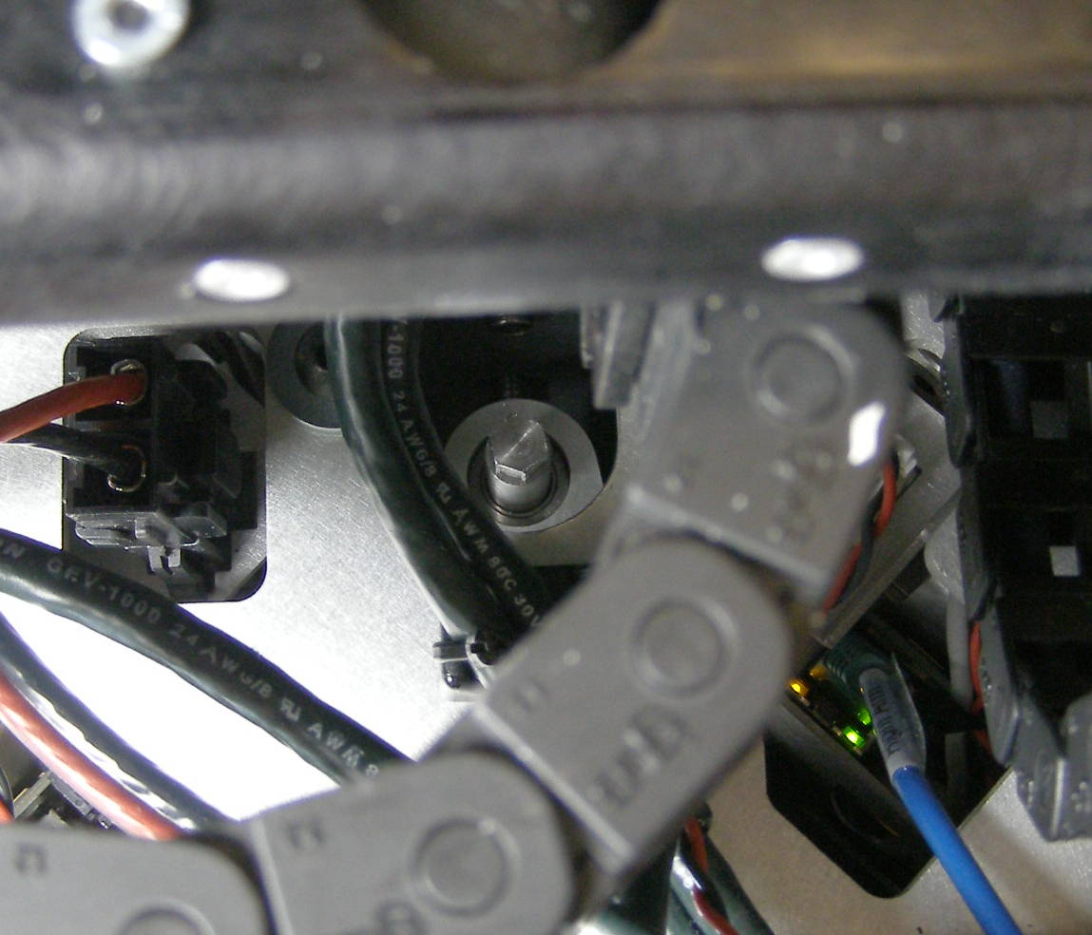
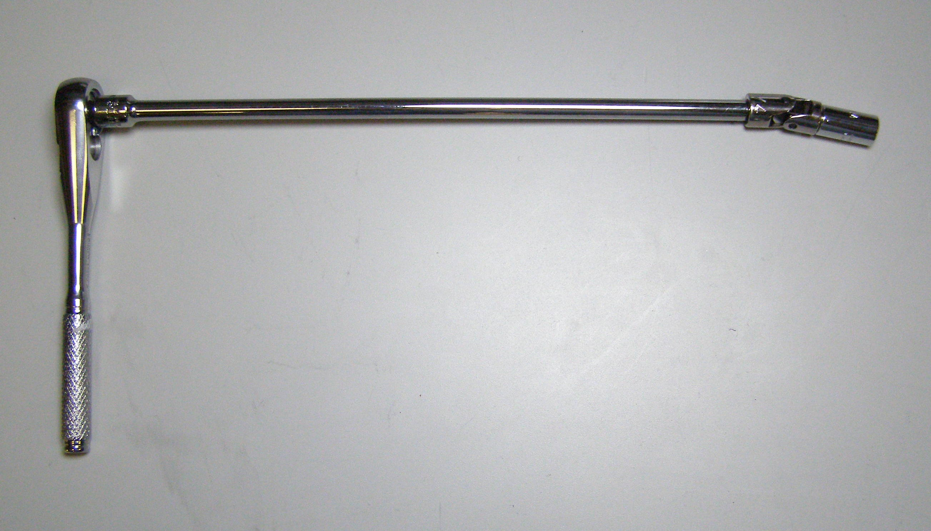
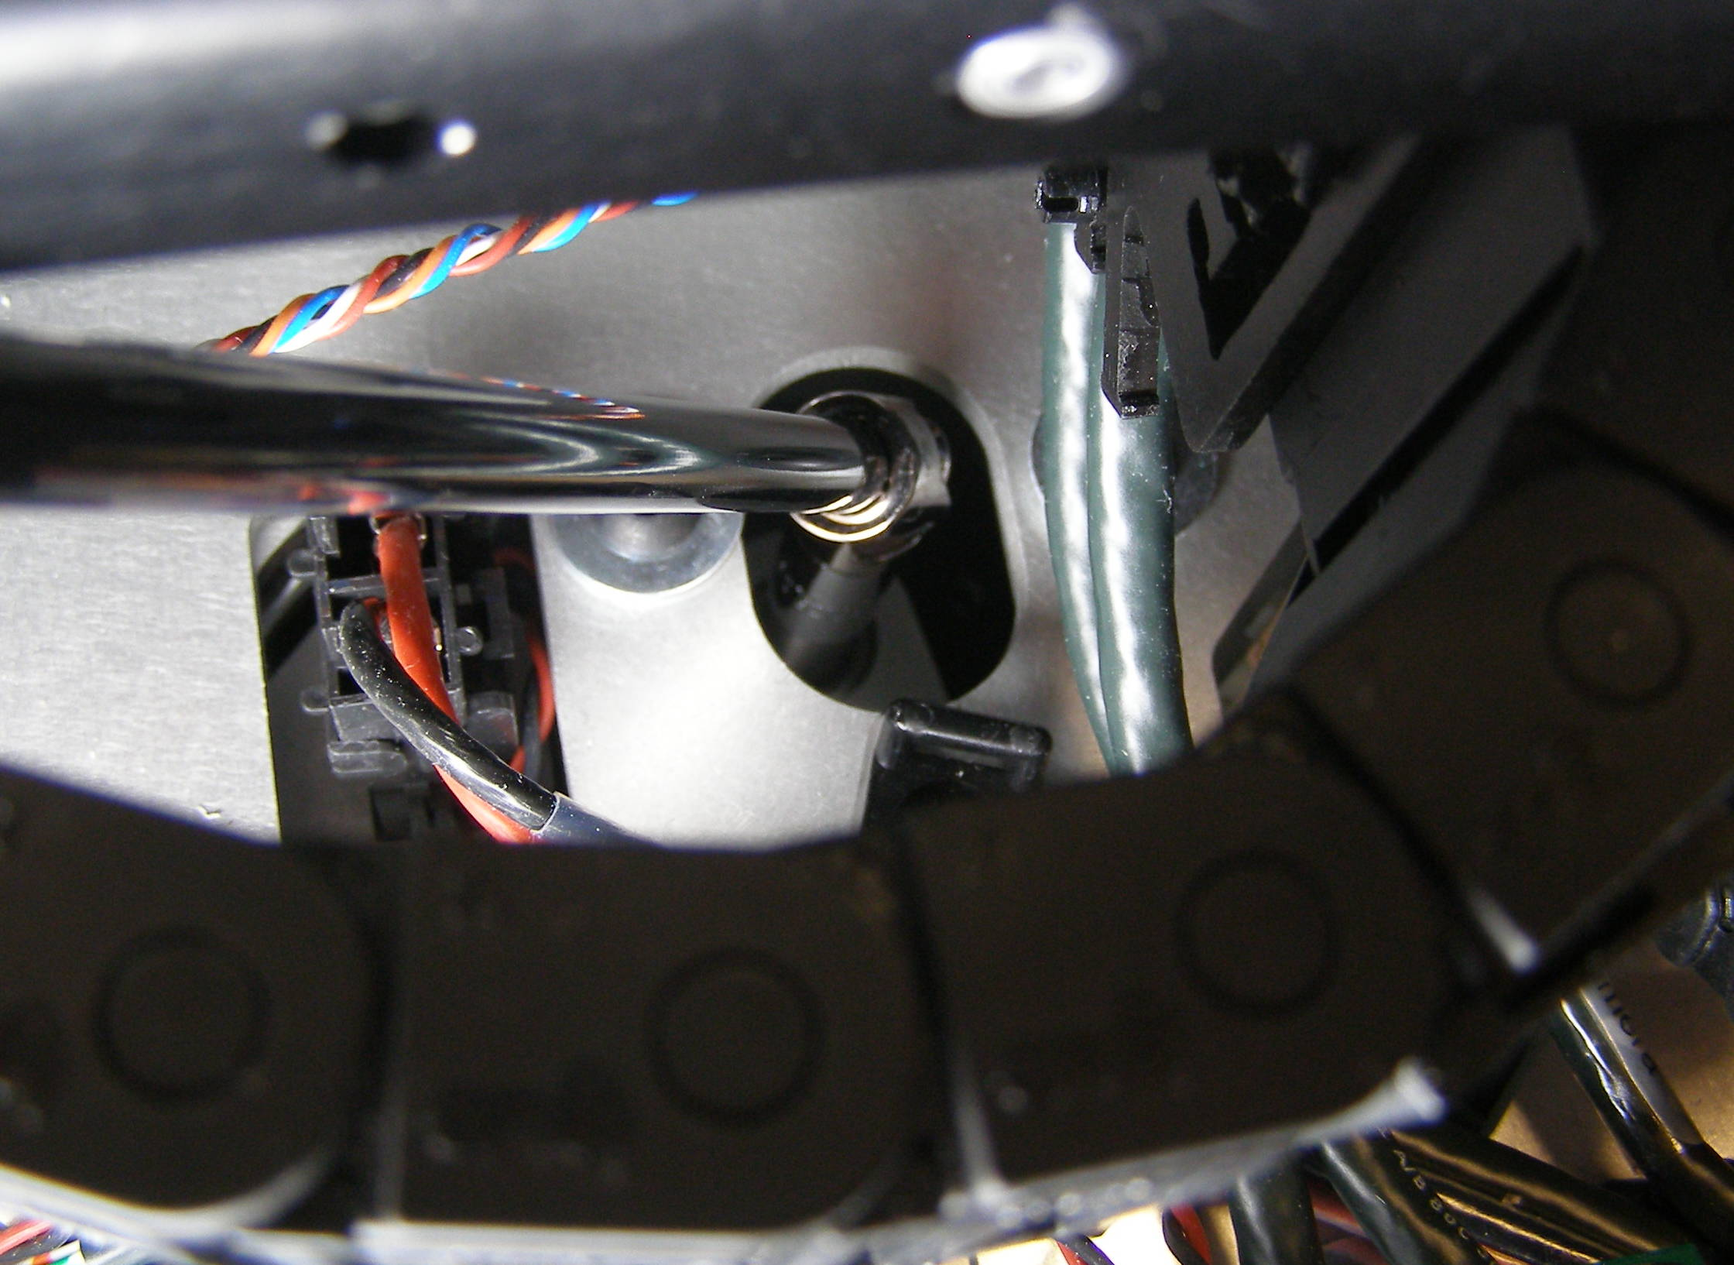
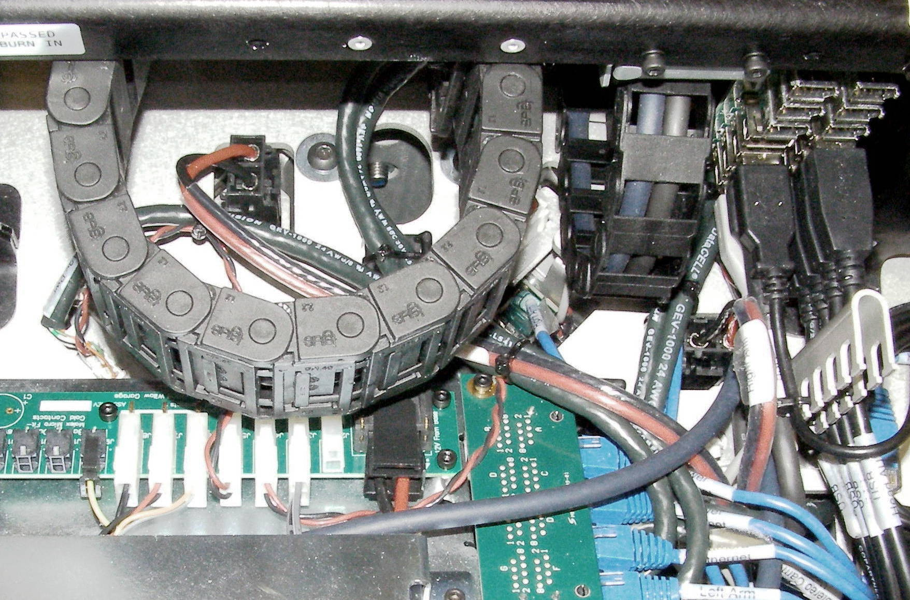
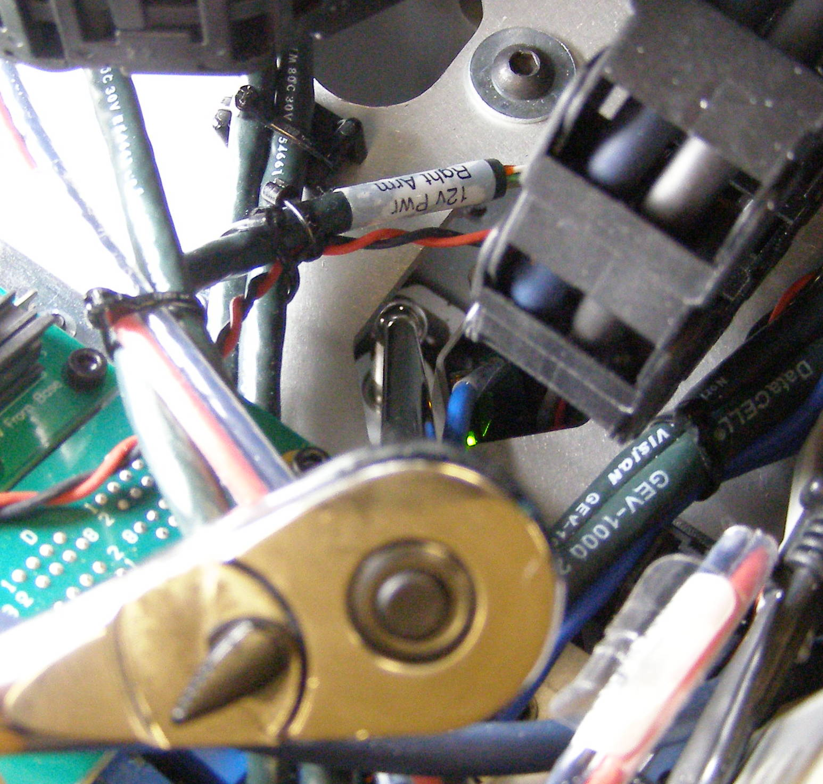
Raise / Lower Spine
Requires two people to raise/lower spine
Raise / Lower Spine
  Remove Top Rear Body Panel
  It may be necessary to remove the Head Pan Rear Panel to raise the spine more than 10cm.
  Assemble tools: 1/4 drive wrench, extension, swivel, and 8mm socket. (Fig 1)
  Insert assembled tool through access hole A and engage the hex sided top of the shaft.
  (Fig 2,3,4)
Fig 3
Fig 1
Fig 4
A
A
B
  Rotate the wrench clockwise to raise, counter-clockwise to lower. Through this access hole the spine can be raised 13cm.
  From access hole B the spine can be raised an additional 2.5cm. (Fig 5)
Fig 2
Fig 5
B

